Slide 1
Dealing with diversity: Rethinking the Lecture – Seminar Format in Language and Content Provision
Joanne Hooker and John Holder

Slide 2
Why?
Engagement
Diversity and WP
Employability ( CBI & UUK 2009)
Two units involved in this pilot
Applied and Academic English (Lower Advanced)
Mix of academic skills & employability
13 week module
Contemporary International Issues
L5 unit on BA (Hons) International Business Management
Assessment = presentation & portfolio
Diverse cohort

Slide 3
Essentially this is a flipped classroom….

Slide 4
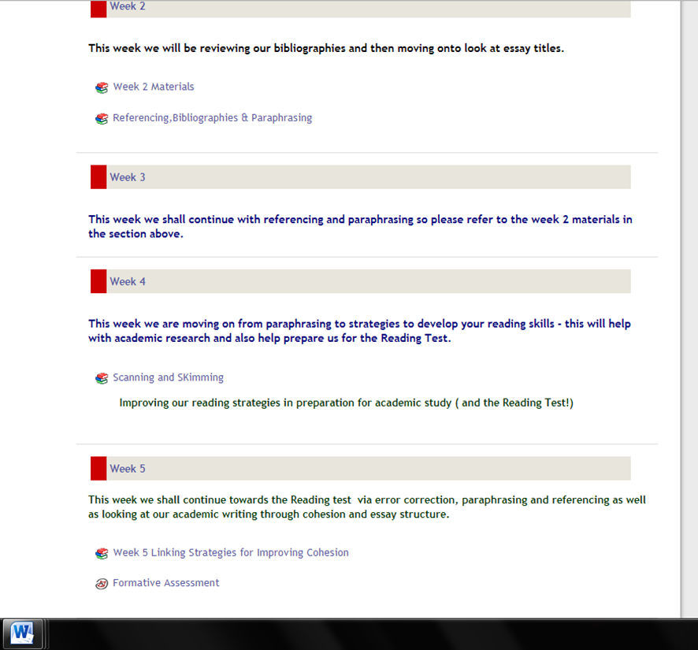
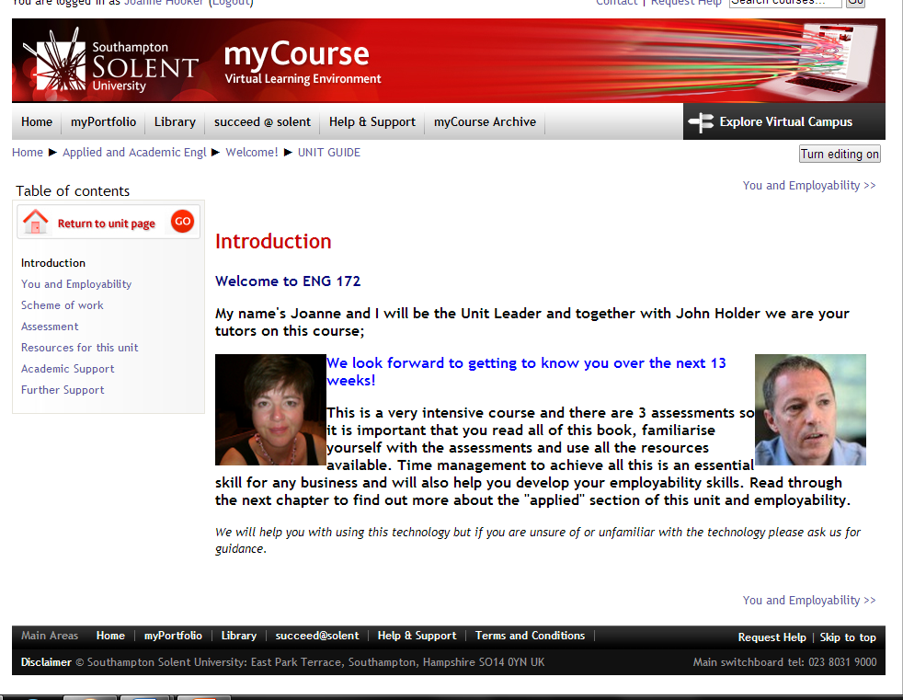
How?
Book tools to make all materials available online for both language and content classes
Neater /easier to navigate
Flexible presentation of content
Available 24/7

Slide 5
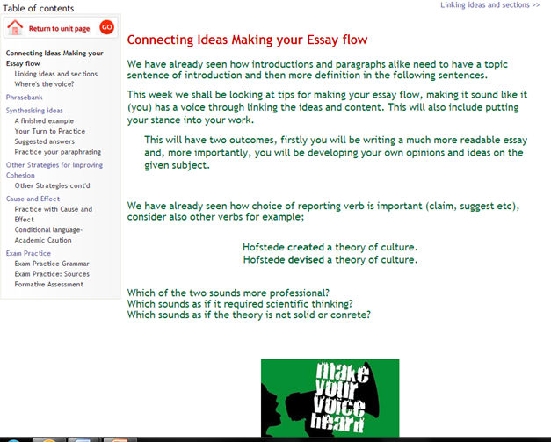
Flexible delivery in the flipped classroom
Lecture seminar replaced by 2 hour workshops, twice a week
Session one: intro & initial research, session 2: ss report findings in groups (which changed each week)
Teacher led input reduced – culture shock for some internationals ss
Ss given guidance & time to follow own research in class
Also allows familiarisation with technology

Slide 7
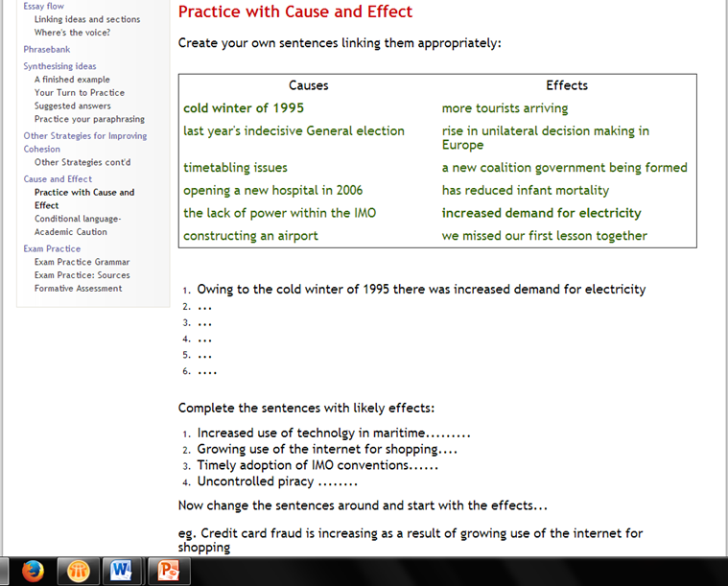
Worthwhile?
Time intensive preparation especially for the contemporary unit which will change according to global events and languages for inputting exercises
Ss tendency to use google or wikipedia rather than given sources
Assumes technical ability of ss
Some initial resistance from ss used to “coasting” classes

Slide 8
Worthwhile?
Our perspectives:
Greater cohesion, stronger attendance and engagement
Foundation for L6 in terms of wider knowledge & critical thinking
Consolidates skills from other units; research, independence etc
Enhances transferable skills & employability and boosts confidence
Student feedback
Garnered through online surveys and face to face focus group discussion
Generic Southampton Solent Survey as unit feedback
Specific Survey Monkey investigation
High response rate
Generally ss appreciated flexibility of the workshops
Acknowledged their own progress and development of skills such as: research, expressing own ideas, understanding other cultures but crucially some did not link that with perceived employability

Slide 9
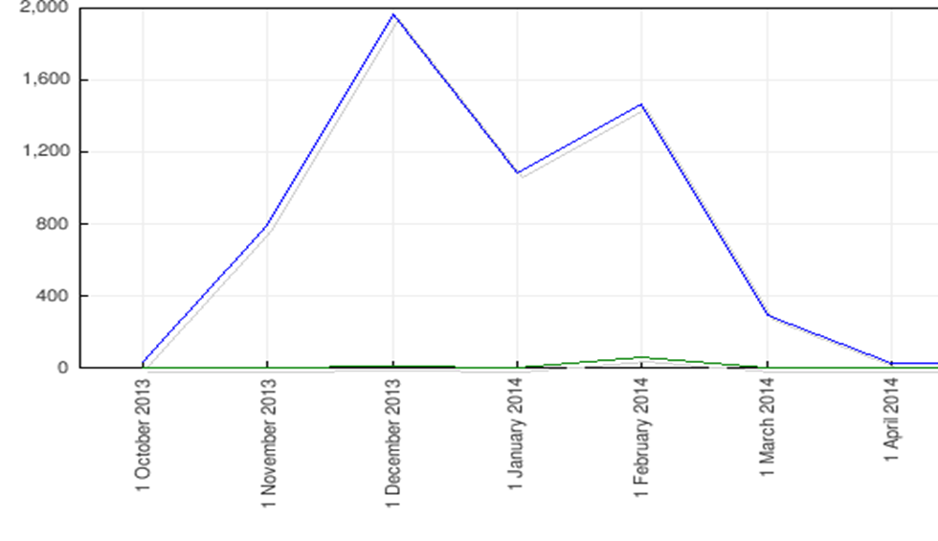
Student comments
“I have really enjoyed the lectures, especially when we discuss each topic in class and share ideas….The mini-presentations have made me more confident when speaking in front of the class…..”
“a good way to go
through a topic better
than a simple seminar
and lesson”
“i improved my interpersonal skills in english which i really appreciate. "

Slide 10
More comments from ss
“The strenghts of this unit are the fact that we were allowed to give our opinions and express ourselves in group or individually”
“Topics are very interesting - not once was I bored Topics are discussed in such depth that I was able to ask questions and make sure I fully understood the different issues and concepts”

Slide 11
Next time…….
Try more interactive activities for AAE
Make sure ss all sit where they can see the board- some couldn’t read the exercises on screen!
Team teaching where possible
Make the link with employability/transferable skills clearer from start
Focus on developing IT skills sooner in course

Slide 12
Thank you very much ….
If you have any queries we’ll be happy to try and answer them

